Slide 1
Objectives
In this session, you will learn to:
  Manipulate folders and files
Notes:
Share the session objectives with the students.

Slide 2

Managing Files and Folders
Are there any common tasks that can be performed both on files and folders?

Slide 3
Managing Files and Folders (Contd.)
Yes, there are some common tasks that can be performed on both files and folders.
  The common tasks that can be performed on
  files and folders are:
  Make a new folder
  Create a new file
  Rename
  Copy
  Move
  Delete

Slide 4
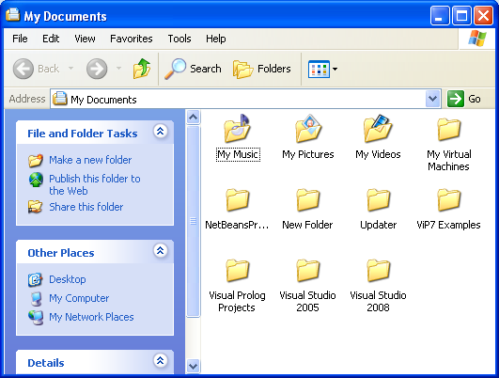
Managing Files and Folders (Contd.)
The tasks list is given under File and Folder Tasks section, as shown in the following figure.
File and Folder Tasks
Notes:
Tell the students that dimensions are components of data mart/ data warehouse. Dimensions will be discussed in details in Ch5.

Slide 5
Managing Files and Folders (Contd.)
.
Let us see how to create a new folder.
Notes:
The following example can be given to explain the federated approach:
Consider a scenario where a manufacturing company called MakeProducts, Inc. is having several business processes and sister concerns. Each of the business processes and sister concerns have their own data warehouses. Now, consider a situation where the senior management of the company decides to develop a company- wide data warehouse encompassing the business processes and sister concerns. In such a case, the company can select the federated approach, where the existing data warehouses are integrated to form a company-wide data warehouse.

Slide 6
Managing Files and Folders (Contd.)
.
Let us see how to create a file.
Notes:
The following example can be given to explain the federated approach:
Consider a scenario where a manufacturing company called MakeProducts, Inc. is having several business processes and sister concerns. Each of the business processes and sister concerns have their own data warehouses. Now, consider a situation where the senior management of the company decides to develop a company- wide data warehouse encompassing the business processes and sister concerns. In such a case, the company can select the federated approach, where the existing data warehouses are integrated to form a company-wide data warehouse.

Slide 7
Managing Files and Folders (Contd.)
.
Let us see how to rename files and folders.
Notes:
The following example can be given to explain the federated approach:
Consider a scenario where a manufacturing company called MakeProducts, Inc. is having several business processes and sister concerns. Each of the business processes and sister concerns have their own data warehouses. Now, consider a situation where the senior management of the company decides to develop a company- wide data warehouse encompassing the business processes and sister concerns. In such a case, the company can select the federated approach, where the existing data warehouses are integrated to form a company-wide data warehouse.

Slide 8
Managing Files and Folders (Contd.)
.
Let us see how to copy files and folders.
Notes:
The following example can be given to explain the federated approach:
Consider a scenario where a manufacturing company called MakeProducts, Inc. is having several business processes and sister concerns. Each of the business processes and sister concerns have their own data warehouses. Now, consider a situation where the senior management of the company decides to develop a company- wide data warehouse encompassing the business processes and sister concerns. In such a case, the company can select the federated approach, where the existing data warehouses are integrated to form a company-wide data warehouse.

Slide 9
Managing Files and Folders (Contd.)
.
Let us see how to move files and folders.
Notes:
The following example can be given to explain the federated approach:
Consider a scenario where a manufacturing company called MakeProducts, Inc. is having several business processes and sister concerns. Each of the business processes and sister concerns have their own data warehouses. Now, consider a situation where the senior management of the company decides to develop a company- wide data warehouse encompassing the business processes and sister concerns. In such a case, the company can select the federated approach, where the existing data warehouses are integrated to form a company-wide data warehouse.

Slide 10
Managing Files and Folders (Contd.)
.
Let us see how to delete files and folders.
Notes:
The following example can be given to explain the federated approach:
Consider a scenario where a manufacturing company called MakeProducts, Inc. is having several business processes and sister concerns. Each of the business processes and sister concerns have their own data warehouses. Now, consider a situation where the senior management of the company decides to develop a company- wide data warehouse encompassing the business processes and sister concerns. In such a case, the company can select the federated approach, where the existing data warehouses are integrated to form a company-wide data warehouse.

Slide 11
Summary
  In this lesson, you learned that:
  Windows Explorer provides easy access to common tasks. These tasks can be performed on files and folders.
  The common tasks that can be performed on files and folders are:
    Make a new folder
    Create a new file
    Rename
    Copy
    Move
    Delete
  The tasks that can be performed on the file or folder are given under the File and Folder Tasks section.

